Slide 1
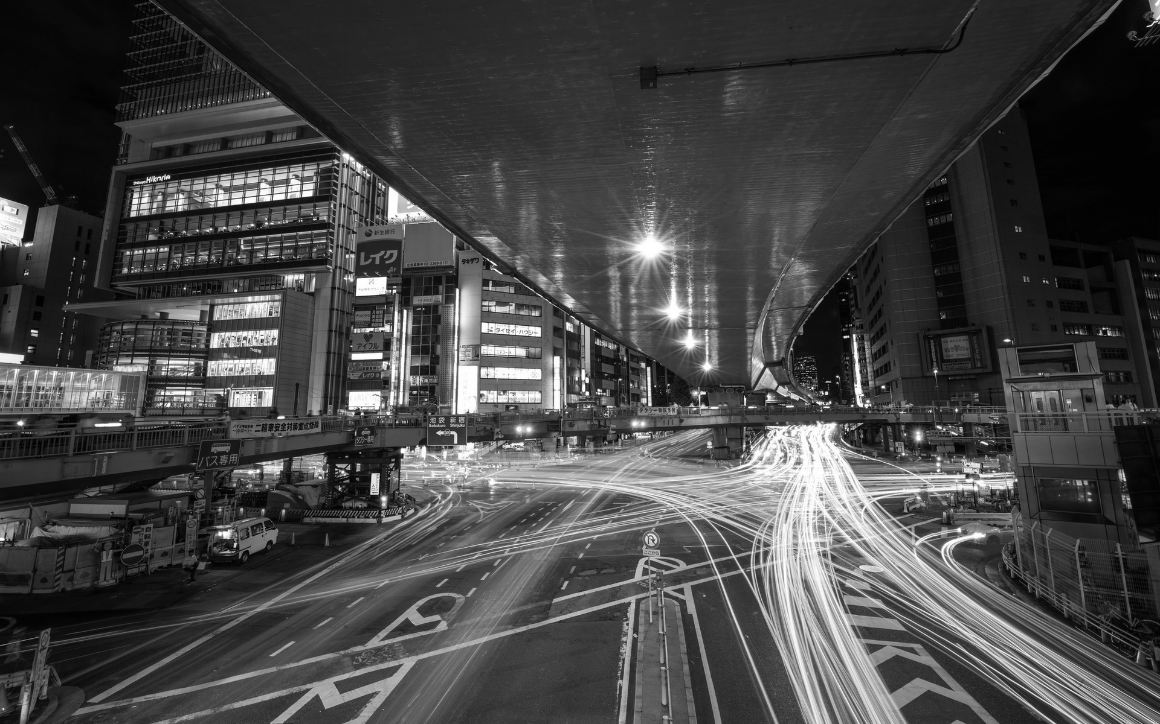
Fighting Congestion and Pollution with self-driving cars
Jackson Romero
Fox Chapel Area High School

Slide 2
Null Hypotheses:
Alternate
Hypotheses:
Increasing the number of smart systems in a grid will NOT significantly reduce traffic congestion.
Increasing the % of smart Lights in a grid will NOT significantly reduce traffic congestion.
Increasing the number of smart systems in a grid will significantly reduce traffic congestion.
Increasing the % of smart lights in a grid will significantly reduce traffic congestion.

Slide 3
Procedure
iterate():void {
this.currentIteration++;
if(this.gridIteration == this.iterations && this.currentIteration == 3) {
this.currentIteration--;
this.gridResults[this.gridIteration-1] = testImprovements();
this.currentIteration++;
console.log(`ALL FINISHED`);
console.log(JSON.stringify(GridController.gridResults));
paused = true;
playPauseButton.elt.innerHTML = 'Play ⏵';
}
else {
//if this is the run after the baseline, run again but modified
if(this.currentIteration == 2) {
this.reset();
console.log(`run adjusted grid ${this.gridIteration}`);
for(let i = 0; i<GridController.Cars.length; i++) {
GridController.Cars[i].reRoute = true;
}
for(let i = 0; i<GridController.Lights.length; i++) {
GridController.Lights[i].smartLogic = true;
}
}
//otherwise if we have baseline and full logic run, test new grid setup
else if(this.currentIteration == 3) {
clearInterval(runInterval);
this.currentIteration--;
this.gridResults[this.gridIteration-1] = testImprovements();
this.currentIteration++;
this.gridIteration++;
console.log(`generateNewGrid ${this.gridIteration}/${this.iterations}`);
//hard reset
this.Lights = [];
this.Roads = [];
this.Cars = [];
this.masterQueue = PriorityQueueFactory();
this.completedQueue = [];
this.masterTime = 0;
this.results = [[]];
this.currentIteration = 1;
generateLights();
generateRoads();
removeLights();
removeRoads();
generateLanes();
continuousCarsDelay = 10/(GridController.Lights.length/50);
paused = undefined;
setUpCars(GridController.Lights.length*4);
startCars();
GridController.masterQueue.enqueue(gridEventFactory(GridController.masterTime, generateContinuousCarsCreateEventHandler(continuousCarsDelay), "first continuous car"));
GridController.masterQueue.enqueue(gridEventFactory(GridController.masterTime+continuousCarsTime, stopContinuousCarsCreateEventHandler(), "stops continuous car generation"));
}
Research the fundamentals of grid design
Create an effective model
Introduce smart vehicles
Introduce smart lights
Bug Fix / Quality of Life Improvements
Analyze results

Slide 4
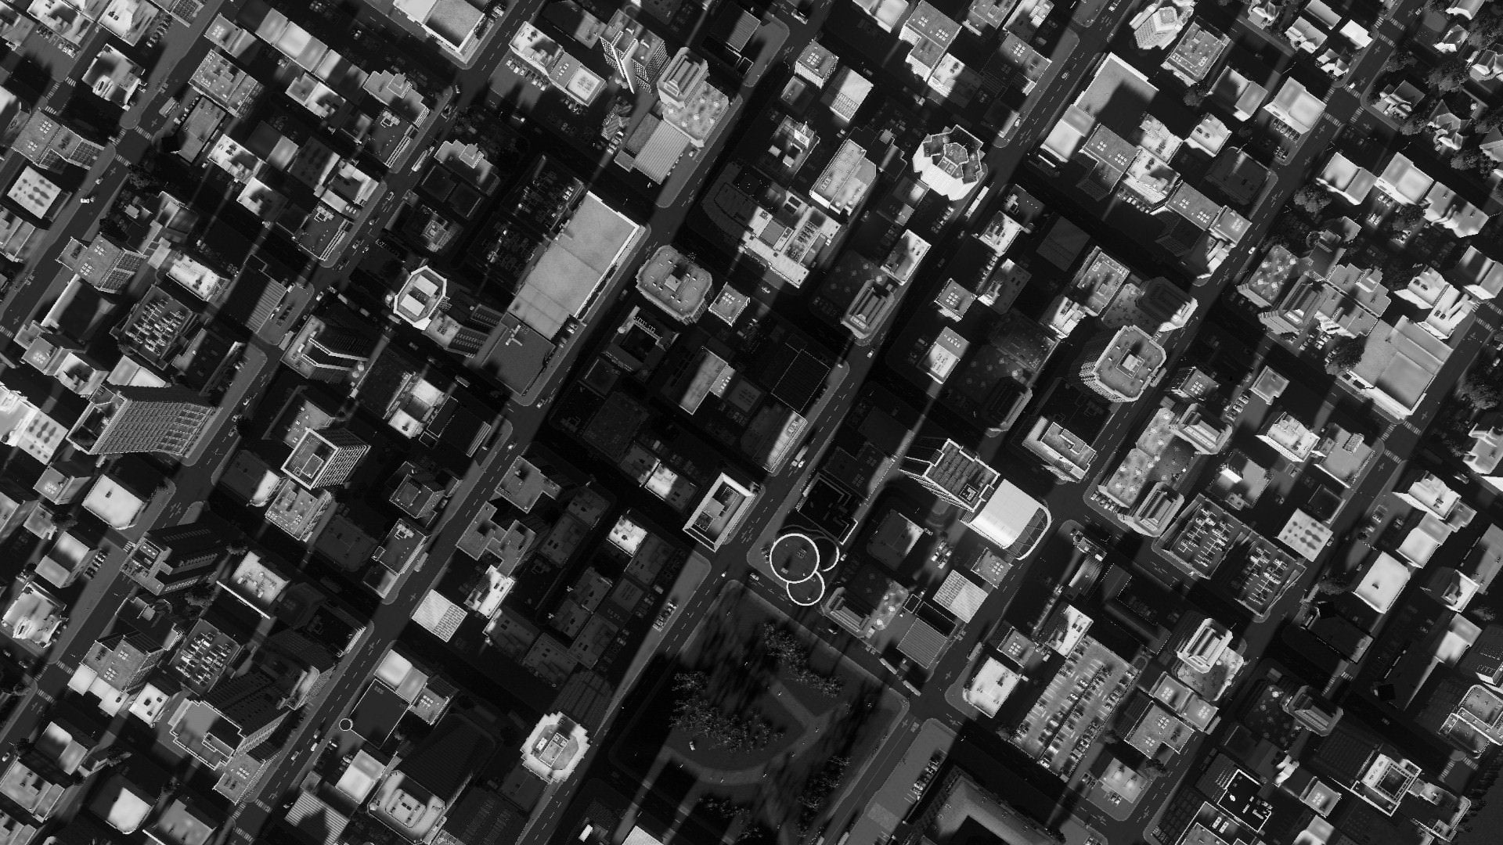
The Grid

Slide 5
Overview
lights
Laid out in a grid
Optional smart-light functionality
Roads & lanes
Connect lights
Lanes are one-way, roads are parent of 2 lanes
Lanes keep track of queues and speeds
cars
Have entrance and exit
Optional smart-rerouting functionality
Actually control queues

Slide 6
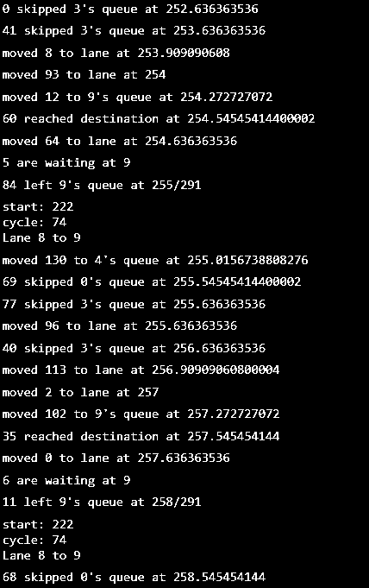
Priority queue
Implemented via a heap
Keeps track of all events and when they are to execute
Allows for detailed logging of events and path tracing
Was crucial in bug-fixing the program

Slide 7
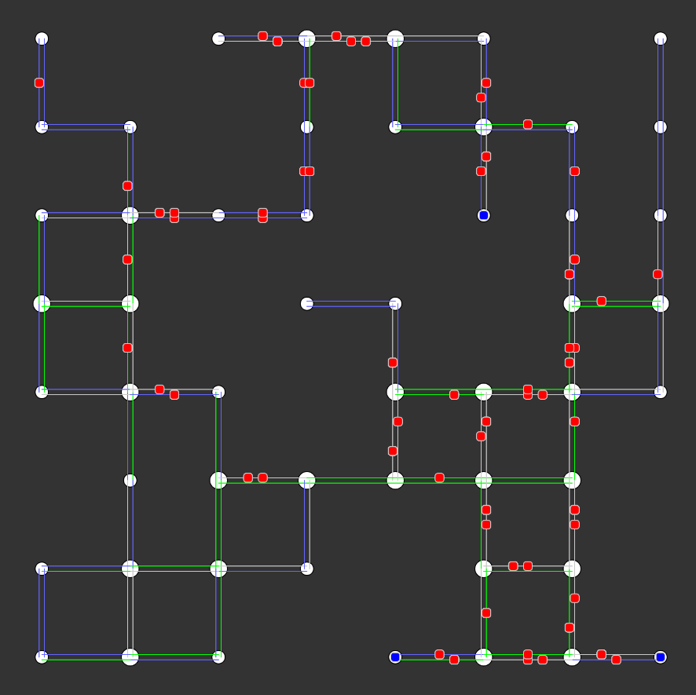
lights
Smaller lights indicate 2-way, so no logic
Roads & lanes
Green active now
White inactive now
Blue always active
cars
On lane when visually in middle
In light queue at an end
Blue dot = finished

Slide 8
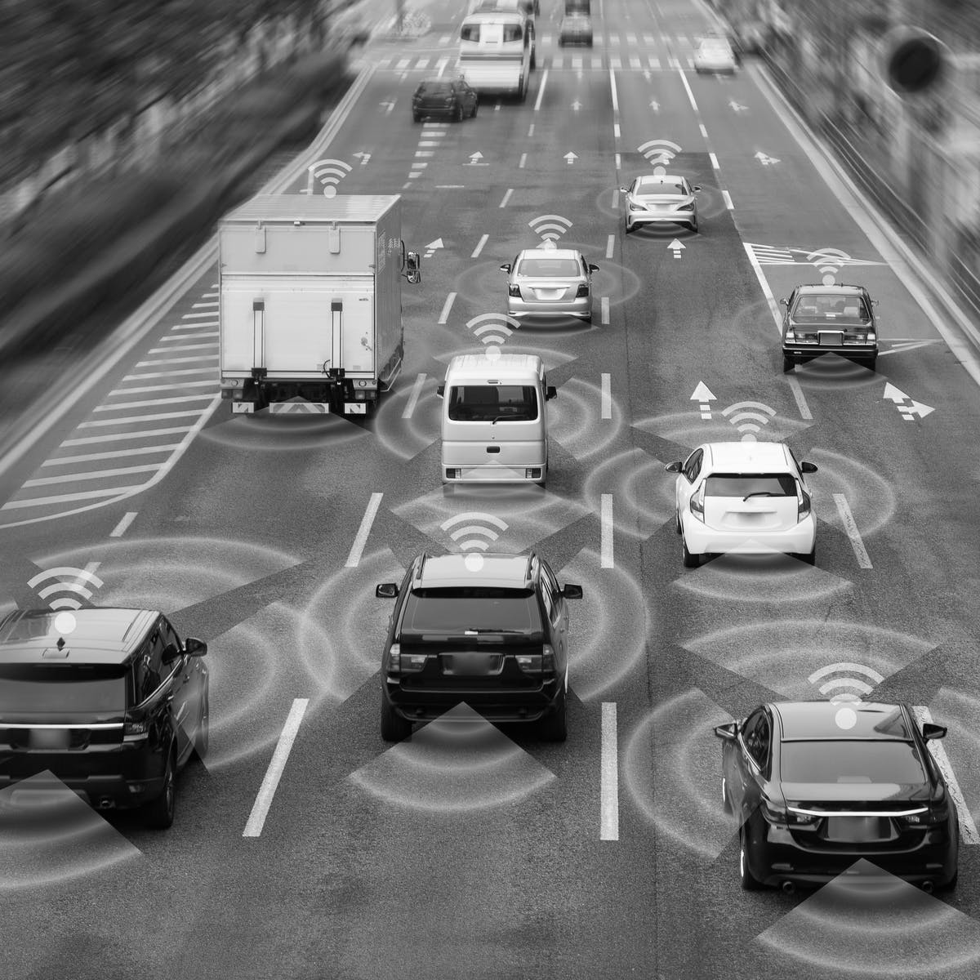
improvements

Slide 9
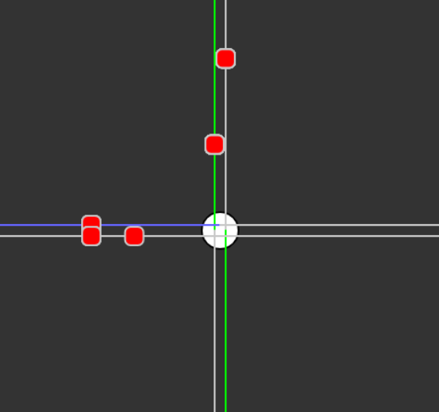
Light Logic
Opposite Lanes green at same time
Car in north queue will go through almost immediately
Car in west queue must wait
Eventually light will cycle

Slide 10
Smart-light logic
If no cars are waiting upon arrival, immediately begin switching to the lane of the new car
If a car is the last to leave its queue, and there are cars waiting on other lanes, immediately begin switching away from current active lanes
Imagine as pressure sensor or camera equipped lights today

Slide 11
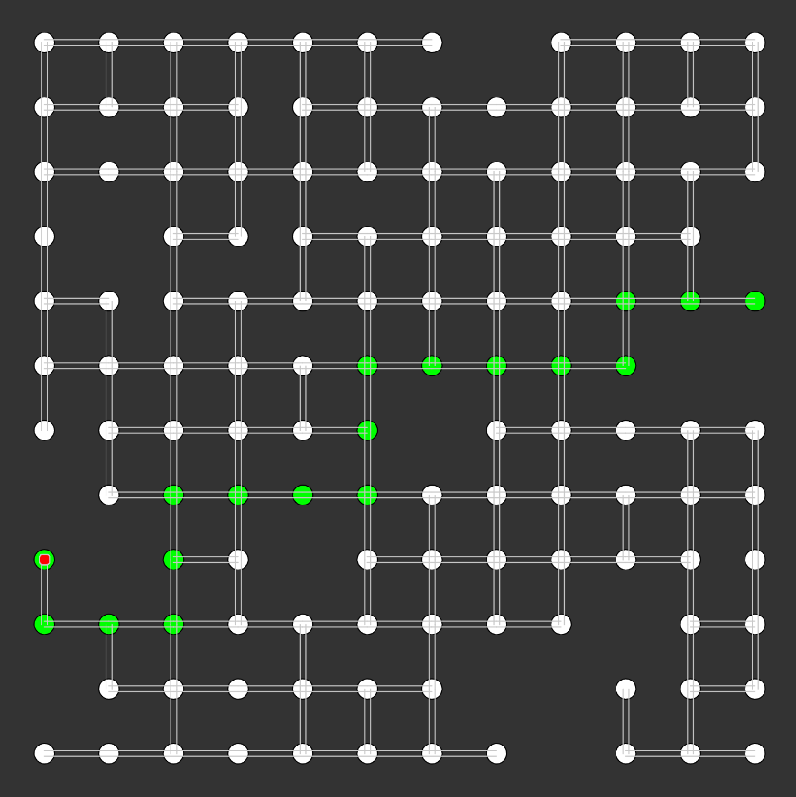
Car Logic
Will find shortest path to its exit using the a* algorithm
Tries to spawn on a light with only 1 neighbor and end on a light with only 1 neighbor
This forces the car to move from low to high congestion during its journey
Keeps track of total time and distance

Slide 12
Smart-Car Logic
Dynamically re-runs a* at every light while taking into account that light’s congestion
A* evaluates a potential path’s cost based on how close it moves towards the destination
To reroute during congestion, add # of cars at a light to that cost calculation
Weight determined through experimentation

Slide 13

Experimentation

Slide 14
Overview
Negative numbers in the following slides represent improvement over a baseline run with no smart-light or smart-car functionality
All tests with the same parameters
Road Length
~400ft (average city block)
Grid-size
10
Road-Gen %
90%
Light-Gen %
80%
Total Cars
422
Continuous cars for 10min

Slide 15
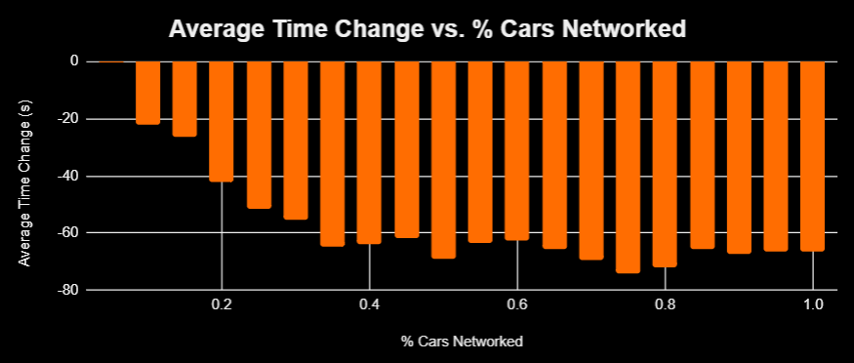
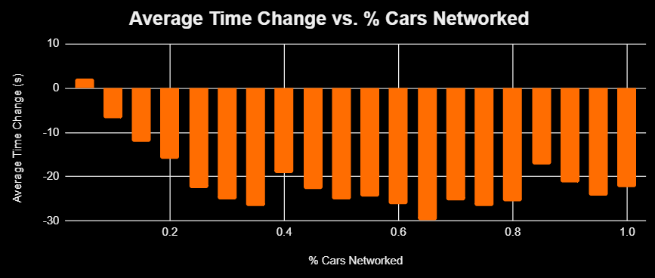
Smart-Car Networking %
Same grid, % of cars networked
Networked cars can only use other networked cars in their re-routing calculations. Imagine google maps
Two trials shown, different grids
Levels off around 35%

Slide 16
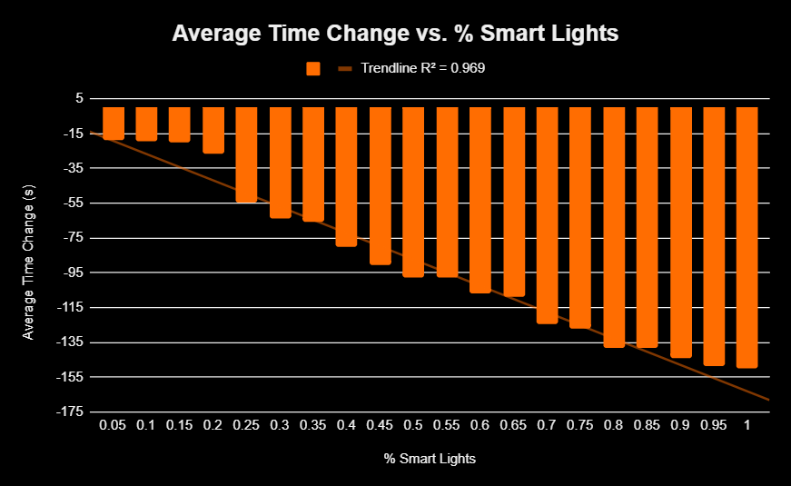
Smart-Light %
Run over the same grid while increasing the % of smart lights
Plots average time difference of cars between baseline run and smart run

Slide 17
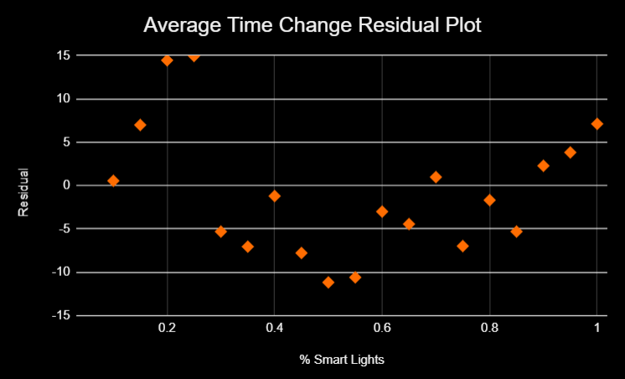
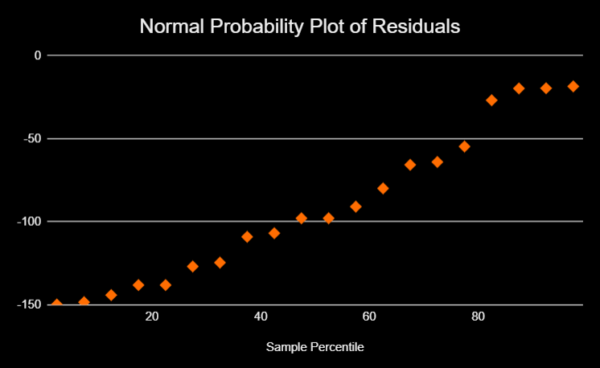
Statistical Analysis
Linear Regression T Test Conditions
Linear Residual Plot: ✓, no obvious pattern
Independent Results: ✓, random simulation
Normal: ✓, normal probability plot Linear
Equal Variance: ✓, from residual plot
Random: ✓, Results are random sample of all results

Slide 18
Statistical Analysis
Results:
Intercept = -11.456s
Slope = -157.667
P(Slope) = 4.718 x 10⁻¹⁵
95% Confidence Interval for Slope: (-165.059, -138.274)
Reject the second null hypothesis; smart lights have statistically significant positive effects on congestion

Slide 19
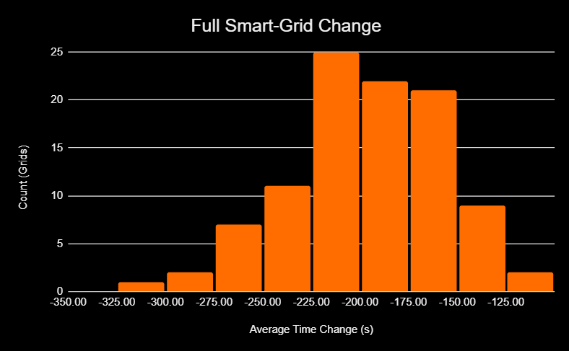
All Optimizations
Run over multiple grids of the same size
Plot is the differences between a baseline run with no optimizations and a run with all optimizations

Slide 20
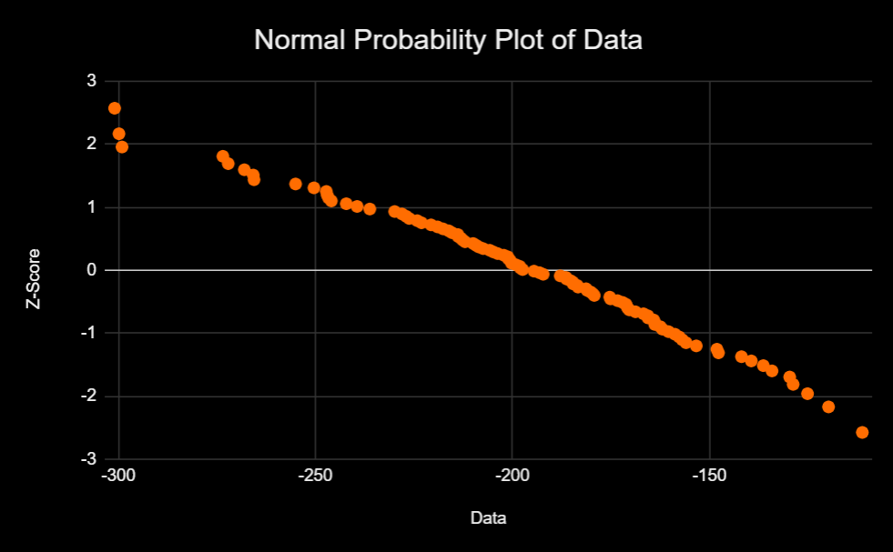
Statistical Analysis
One Sample T-Test Conditions:
Random: ✓, Results are random sample of all results
Normal: ✓, Normal probability plot linear
Independent Results: ✓, Random simulation

Slide 21
Statistical Analysis
Results:
Sample Mean = -196.466s
T-Stat = -48.63
P = 0
Reject the first null hypothesis; smart cars and smart lights have statistically significant positive effects on congestion

Slide 22
Limitations:
Extensions:
Lack of granularity in the grid
Chance of logic errors
Very slow with larger grids
Not representative of the real world
Add more detail to the program
Improve efficiency of code
Allow custom grid generation (e.g. import Pittsburgh)

